Slide 1
Regression
Linear Regression

Slide 2
Linear Regression
It is a simple model but everyone needs to master it as it lays the foundation for other machine learning algorithms.
It can be used to understand the factors that influence profitability.
It can be used to forecast sales in the coming months by analyzing the sales data for previous months.
It can also be used to gain various insights about customer behaviour.

Slide 3

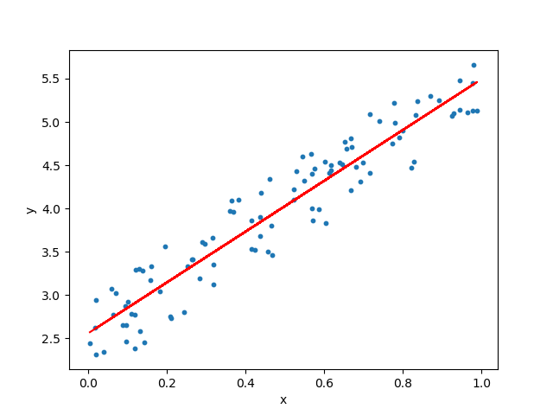
Linear regression
The objective of a linear regression model is to find a relationship between one or more features(independent variables) and a continuous target variable(dependent variable).
When there is only feature it is called Uni-variate Linear Regression
if there are multiple features, it is called Multiple Linear Regression.

Slide 4
Hypothesis of Linear Regression
The linear regression model can be represented by the following equation
Y is the predicted value
θ₀ is the bias term.
θ₁,…,θₙ are the model parameters
x₁, x₂,…,xₙ are the feature values.

Slide 5
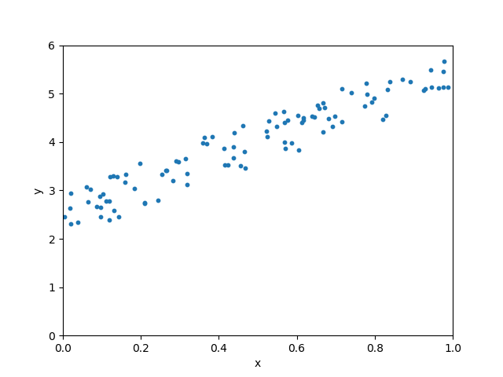
Hypothesis of Linear Regression
θ is the model’s parameter vector including the bias term θ₀
x is the feature vector with x₀ =1
Training of the model here means to find the parameters so that the model best fits the data.

Slide 6
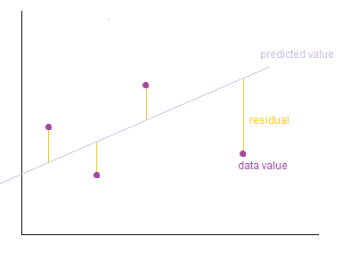
How do we determine the best fit line?
The line for which the error (Residuals) between the predicted values and the observed values is minimum is called the best fit line or the regression line.
To define and measure the error of our model we define the cost function as the sum of the squares of the residuals.

Slide 7

The cost function
The cost function is denoted by:
where the hypothesis function h(x) is denoted by
m is the total number of training examples in our data-set.

Slide 8
Training a Linear Regression Model
Why do we take the square of the residuals and not the absolute value of the residuals ?
We want to penalize the points which are farther from the regression line much more than the points which lie close to the line.
Our objective is to find the model parameters so that the cost function is minimum. We will use Gradient Descent to find this.

Slide 9
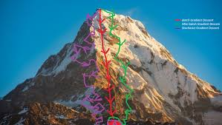
Gradient descent
Gradient descent is a generic optimization algorithm used in many machine learning algorithms.
It iteratively tweaks the parameters of the model in order to minimize the cost function.

Slide 10


gradient descent
We first initialize the model parameters with some random values. This is also called as random initialization.
Now we need to measure how the cost function changes with change in it’s parameters. Therefore we compute the partial derivatives of the cost function w.r.t to the parameters θ₀, θ₁, … , θₙ
Notes:
partial derivatives
we want to see how the function changes as we let just one of those variables change while holding all the others constant.
The gradient of a function f, is the collection of all its partial derivatives into a vector.

Slide 11

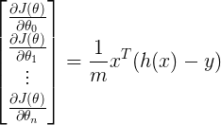
gradient descent
the partial derivative of the cost function w.r.t to any parameter can be denoted by:
We can compute the partial derivatives for all parameters at once using:
where h(x) is

Slide 12


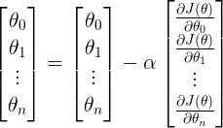
gradient descent
After computing the derivative we update the parameters as given below
where alpha is the learning parameter.
We can update all the parameters at once using:

Slide 13
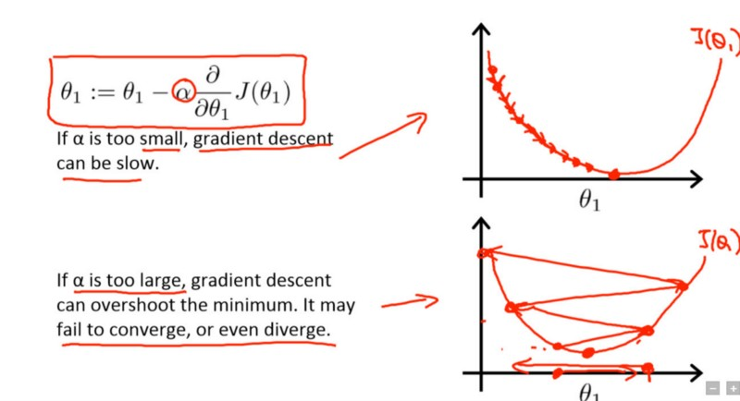
Gradient descent
We repeat the earlier steps until the cost function converges to the minimum value.
To demonstrate the gradient descent algorithm, we initialize the model parameters with 0. The equation becomes Y = 0. Gradient descent algorithm now tries to update the value of the parameters so that we arrive at the best fit line.

Slide 14
When the learning rate is very slow, the gradient descent takes larger time to find the best fit line.

Slide 15
When the learning rate is normal

Slide 16
When the learning rate is arbitrarily high, gradient descent algorithm keeps overshooting the best fit line and may even fail to find the best line.

Slide 17
Gradient descent

Slide 18

Evaluating the performance of the model
Root mean squared error(RMSE) and Coefficient of Determination(R² score) are popularly used to evaluate regression model.
RMSE is the square root of the average of the sum of the squares of residuals.
RMSE is defined by

Slide 19



Evaluating the performance of the model
R² is determined by
SSₜ is the total sum of errors if we take the mean of the observed values as the predicted value.
SSᵣ is the sum of the square of residuals

Slide 20
R Square
SSₜ - 69.47588572871659 SSᵣ - 7.64070234454893 R² score - 0.8900236785122296
If we use the mean of the observed values as the predicted value the variance is 69.47588572871659 and if we use regression the total variance is 7.64070234454893. We reduced the prediction error by ~ 89% by using regression

